Slide 1
End-Times Prophecies
John Messina

Slide 2
What questions will we answer?
  Should you believe any of this?
  Are we in the end-times?
  What prophecies support this being the end-times?
  Can we know when the Tribulation will occur?
  When will it be the last generation?
  How does Israel’s spiritual awakening align with the Tribulation?
  Can we refine the Tribulation dates?
  What evidence is there of Satan’s rise to power?
  When will the Rapture occur?
  What should we do next?

Slide 3
Should you believe any of this?

Slide 4
Never take prophetic analysis at face value
  Why prophetic interpretations fail
    They try to bend scripture to their ideology
    They claim special insights that have no basis in scripture
  I have no special knowledge, insights, or revelation by God
    I admit my analysis is inherently flawed
    I take scripture literally and allow it to guide my conclusions
    I attempt to validate my theory through multiple prophecies within scripture

Slide 5
Never take prophetic analysis at face value
  Interpreting biblical prophecy is like looking through a glass of water
    Even if the water is clear, the image is always distorted
    God will do things at His appointed time, which may or may not be revealed
  Paul says to test all things (1 Thessalonians 5:21-22)
    While based on scripture, if any interpretation, assumption, or conclusion is incorrect, the house of cards falls
  Independently study God’s word, do research, and ask for God’s wisdom and guidance through prayer

Slide 6
Are we in the end-times?

Slide 7
Bottom Line Up Front!
  Are we in the last days?
  No!
  We have been in the last days since Jesus ascended into Heaven 2,000 years ago
    We are not just in the last day…
    We are not just in the last hour…
    We are not just in the last minute…
  We are in the last seconds!

Slide 8
Does this sound familiar?
  “There will be terrible times in the last days. People will be lovers of themselves, lovers of money, boastful, proud, abusive, disobedient to their parents, ungrateful, unholy, without love, unforgiving, slanderous, without self-control, brutal, not lovers of the good, treacherous, rash, conceited, lovers of pleasure rather than lovers of God—having a form of godliness but denying its power.” 2 Timothy 3:1-5
  Paul’s description of the last days certainly fits this generation

Slide 9
Jesus’ Olivette Discourse is the key
  “Now learn this lesson from the fig tree: As soon as its twigs get tender and its leaves come out, you know that summer is near. Even so, when you see all these things, you know that it is near, right at the door. Truly I tell you, this generation will certainly not pass away until all these things have happened. Heaven and earth will pass away, but my words will never pass away.” Matthew 24:32-35
  The fig tree always represents the nation of Israel.

Slide 10
Jesus’ Olivette Discourse is the key
  “Now learn this lesson from the fig tree: As soon as its twigs get tender and its leaves come out, you know that summer is near. Even so, when you see all these things, you know that it is near, right at the door. Truly I tell you, this generation will certainly not pass away until all these things have happened. Heaven and earth will pass away, but my words will never pass away.” Matthew 24:32-35
  Tender twigs, new leaves, and the coming of summer represents rebirth.

Slide 11
Jesus’ Olivette Discourse is the key
  “Now learn this lesson from the fig tree: As soon as its twigs get tender and its leaves come out, you know that summer is near. Even so, when you see all these things, you know that it is near, right at the door. Truly I tell you, this generation will certainly not pass away until all these things have happened. Heaven and earth will pass away, but my words will never pass away.” Matthew 24:32-35
  “This generation” is the generation that will witness “all these things” that Jesus described as signs of the last generation

Slide 12
Jesus’ Olivette Discourse is the key
  “Now learn this lesson from the fig tree: As soon as its twigs get tender and its leaves come out, you know that summer is near. Even so, when you see all these things, you know that it is near, right at the door. Truly I tell you, this generation will certainly not pass away until all these things have happened. Heaven and earth will pass away, but my words will never pass away.” Matthew 24:32-35
  Jesus confirmed the truth that this will be the sign for the final generation
  The generation that sees the return of Israel will see His return

Slide 13
What prophecies support this being the end-times?

Slide 14
God’s punishment for disobedience
  “Then lie on your left side and put the sin of the people of Israel upon yourself. You are to bear their sin for the number of days you lie on your side. I have assigned you the same number of days as the years of their sin. So for 390 days you will bear the sin of the people of Israel. After you have finished this, lie down again, this time on your right side, and bear the sin of the people of Judah. I have assigned you 40 days, a day for each year.” Ezekiel 4:4-6
430 Total Years of Punishment for Disobedience
Israel’s Sin (390 Years)
Judah’s Sin (40 Years)

Slide 15
The rebirth of the nation of Israel
  “Because you have not listened to my words, I will summon all the peoples of the north and my servant Nebuchadnezzar king of Babylon,” declares the Lord, “and I will bring them against this land and its inhabitants and against all the surrounding nations…This whole country will become a desolate wasteland, and these nations will serve the king of Babylon seventy years.” Jeremiah 25:8-9,11
430 Total Years of Punishment for Disobedience
70 Years of Punishment
360 Years of Punishment Remain

Slide 16
The rebirth of the nation of Israel
  “If after all this you will not listen to me, I will punish you for your sins seven times over.” Leviticus 26:18
  “If you remain hostile toward me and refuse to listen to me, I will multiply your afflictions seven times over, as your sins deserve.” Leviticus 26:21
  “If in spite of these things you do not accept my correction but continue to be hostile toward me, I myself will be hostile toward you and will afflict you for your sins seven times over.” Leviticus 26:23-24
  “If in spite of this you still do not listen to me but continue to be hostile toward me, then in my anger I will be hostile toward you, and I myself will punish you for your sins seven times over.” Leviticus 26:27-28
  It seems like God was trying to drive home a point

Slide 17
The rebirth of the nation of Israel
2,590 Total Years of Punishment for Disobedience
70 Years of Punishment
7x360 Years of Punishment (2,520 Years)
  Prophetic years are 360-day years
2,555 Total Calendar Years of Punishment
69 Years of Punishment
2,486 Years of Punishment

Slide 18
The rebirth of the nation of Israel
The First Cycle of Judgment – Restoration of the Nation
Initial Punishment
Seven-Fold Punishment for Disobedience
539 BC – Israel fails to heed Cyrus’ decree to allow the nation to return
(2 Chronicles 36:22-23; Ezra 1:1-4)
1948 – Israel is restored as a nation
(2 Kings 24:1; Daniel 1:1-7)
608 BC – Israel is exiled to Babylon (2 Kings 24:1; Daniel 1:1-7)

Slide 19
The rebirth of the nation of Israel
The Second Cycle of Judgment – Restoration of the Temple
Initial Punishment
Seven-Fold Punishment for Disobedience
520 BC – Israel fails to heed Cyrus’ decree to rebuild the Temple
(Ezra 4:24)
1967 – Jerusalem and the Temple Mount are restored
(Ezekiel 37:15-22)
589 BC – Jerusalem and the Temple are destroyed
(2 Kings 25:8-9; 2 Chronicles 36:15-20)

Slide 20
The rebirth of the nation of Israel
The Third Cycle of Judgment – Israel’s Spiritual Re-Awakening
Initial Punishment
Seven-Fold Punishment for Disobedience
461 BC – Israel fails to resume rebuilding the Temple when Ezra returns to Jerusalem
(Ezra 6:1-15, 7:8)
2026 – Israel returns to God with their spiritual awakening
(Isaiah 17:8; Ezekiel 36:26-28, 37:9-10)
530 BC – Cambyses becomes king of Babylon and persecutes the Jews
(Daniel 11:2)

Slide 21
Can we know when the Tribulation will occur?

Slide 22
Daniel’s 70th Week
  “He will confirm a covenant with many for one ‘seven.’ In the middle of the ‘seven’ he will put an end to sacrifice and offering. And at the temple he will set up an abomination that causes desolation, until the end that is decreed is poured out on him.” Daniel 9:27
  Daniel’s 70th ‘seven’ is the Tribulation that occurs at the end of days
    This is a seven-year period when the Antichrist rules the world
    The Tribulation begins when the Antichrist makes a peace treaty with Israel
    The abomination that causes desolation occurs at the midpoint of the Tribulation when the Antichrist defiles the Temple
    The Tribulation ends with the Battle of Armageddon when Jesus returns

Slide 23
Daniel’s 70th Week
  We only need one known date to anchor the timeline
  We have two, so the timeline can be validated by independent prophecies
    The prophecies regarding the timing of the last generation
      Define the proposed date when Jesus returns at the end of the Tribulation
    The prophecies regarding the timing of Israel’s spiritual awakening
      Define the proposed date for the Gog and Magog War

Slide 24
When will It be the last generation?

Slide 25
The Last Generation
  The proposed date for when Jesus returns at the end of the Tribulation is based on the timing of the final generation
    The Valley of the Dry Bones prophecy (Ezekiel 37)
      Describes the timeline for the rebirth of Israel
    Ezekiel’s prophecy of punishment for disobedience
      Identifies when Israel would be restored as a nation
      Identifies when Jerusalem and the Temple Mount would be restored
  This is the last generation!

Slide 26
Israel’s Rebirth – The valley of the dry bones
  “Prophesy to these bones and say to them, ‘Dry bones, hear the word of the Lord! This is what the Sovereign Lord says to these bones: I will make breath enter you, and you will come to life. I will attach tendons to you and make flesh come upon you and cover you with skin; I will put breath in you, and you will come to life. Then you will know that I am the Lord.’”
  So I prophesied as I was commanded. And as I was prophesying, there was a noise, a rattling sound, and the bones came together, bone to bone. I looked, and tendons and flesh appeared on them and skin covered them, but there was no breath in them.
  Then he said to me, “Prophesy to the breath; prophesy, son of man, and say to it, ‘This is what the Sovereign Lord says: Come, breath, from the four winds and breathe into these slain, that they may live.’” So I prophesied as he commanded me, and breath entered them; they came to life and stood up on their feet—a vast army.” Ezekiel 37:4-10

Slide 27
Israel’s Rebirth – The valley of the dry bones
  “Then the Lord said, ‘My Spirit will not contend with humans forever, for they are mortal; their days will be a hundred and twenty years.’” Genesis 6:3
1917-2037 – 120 Years for Israel’s Restoration
1917-1967 – 1 Jubilee
1967-2017 – 1 Jubilee
1967 – Israel regains Jerusalem and the Temple Mount.
The Jews begin to return to a desolate land
2017 – Jerusalem is recognized as the capital of Israel.
1948 – The nation of Israel is restored.
1917 – The Balfour Declaration is issued to create a new Jewish state and begins Israel’s restoration.
(Ezekiel 37)
2037 – Jesus returns at the conclusion of the final generation. (Ezekiel 37:23-28; Matthew 24:34-35)

Slide 28
Israel’s Rebirth – The valley of the dry bones
  “Our days may come to seventy years, or eighty, if our strength endures”
  Psalm 90:10
Both methods for calculating the length of a generation result in the same date for Jesus’ return
1917-2037 – 120 Years for Israel’s Restoration
1967-2037 – 70 Years for the Final Generation
1917
1948
2017
1967 – Israel regains Jerusalem and the Temple Mount.
2037 – Jesus returns at the conclusion of the final generation. (Ezekiel 37:23-28; Matthew 24:34-35)

Slide 29
How does Israel’s spiritual awakening align with the Tribulation?

Slide 30
Israel’s Spiritual Awakening
  The proposed date for the Gog and Magog war
    “Then [after the war] those who live in the towns of Israel will go out and use the weapons for fuel and burn them up…For seven years they will use them for fuel.” Ezekiel 39:9
    “For seven months the Israelites will be burying them [Israel’s enemies that died in the war] in order to cleanse the land.” Ezekiel 39:12
    The seven-year and seven-month period for burning the weapons and burying the dead must end at the midpoint of the Tribulation when the Jews flee Israel
      “So when you see standing in the holy place ‘the abomination that causes desolation,’ spoken of through the prophet Daniel—let the reader understand—then let those who are in Judea flee to the mountains.” Matthew 24:15-16

Slide 31
Israel’s Spiritual Awakening
  Israel’s Spiritual Awakening occurs in 2026 according to Ezekiel’s prophecy regarding Israel’s punishment
    This triggers the Gog and Magog war
  The Gog and Magog war must occur four years before the start of the Tribulation
    The war occurs 91 months (7 years + 7 months) prior to the midpoint of the Tribulation, which is 3½ years after the Tribulation begins
    This places the war 49 months (approximately 4 years) before the start of the Tribulation
  The Gog and Magog war must occur in 2026

Slide 32
The Tribulation Timeline
  The two anchor events independently correlate the proposed Tribulation timeline!
Both the prophecies for the last generation and Israel’s spiritual awakening point to the Tribulation ending in 2037
2030-2037 – The Tribulation Period
2026-2034 – Weapons Burned
2030 – The Start of the Tribulation
The Lesser Tribulation – 3½ Years
The Great Tribulation – 3½ Years
2034 – Midpoint of the Tribulation
2026 – Israel’s spiritual awakening occurs, triggering the Gog & Magog War (Ezekiel 38-39)
2037 – Jesus returns to establish His Millennial Kingdom

Slide 33
Can we refine the Tribulation dates?

Slide 34
Christ’s 1st coming Fulfilled The Spring Feasts
Event | Feast | Description | Date
Christ’s Crucifixion | Passover (Pesach) | Jesus was crucified during Passover and was the sacrificial “lamb without blemish or defect” because His life was completely free from sin. | Friday, April 1, 33 AD
Christ in the Grave | Feast of Unleavened Bread | Jesus’ sinless life made Him the perfect sacrifice for our sins. His body was in the grave during the first days of this feast, like a kernel of wheat planted and waiting to burst forth as the bread of life. | Saturday, April 2, 33 AD
Christ's Resurrection | Feast of First Fruits | Jesus was resurrected on this very day, which is one of the reasons that Paul refers to him as the "first fruits from the dead.” His resurrection is the first fruits of the righteous. | Sunday, April 3, 33 AD
Receipt of the Holy Spirit | Pentecost (Shavuot) | The Feast of Weeks or Pentecost pointed to the great harvest of souls and the gift of the Holy Spirit for both Jew and Gentile, who would be brought into the kingdom of God during the Church Age. Apostles received Holy Spirit 50 days after Jesus’ resurrection, guaranteeing that the promise of salvation and future resurrection will come to pass. | Monday, May 23, 33 AD

Slide 35
Christ’s 2nd coming will Fulfill The Fall Feasts
Event | Feast | Description | Date
Gog and Magog War | Parshat Vayera | This war occurs 4 years before the start of the Tribulation (7 months for Israel to bury the dead plus 7 years to burn the weapons for fuel) until they are forced to flee at the start of the Great Tribulation and commemorates God’s visit to Abraham before He destroys Sodom. | Saturday, October 31, 2026
Start of the Tribulation | Parshat Bereshit | The Tribulation starts 7 years (2,520 days) prior to the end of the Great Tribulation and commemorates God’s creation of the universe. | Saturday, October 26, 2030
Start of the Great Tribulation | Passover Shabbat (Pesach) | The Great Tribulation starts 3½ years (1,260 days) after the start of the Tribulation. This is the Sabbath that occurs during Passover. | Saturday, April 8, 2034
Return of Christ and the Battle of Armageddon | Feast of Trumpets (Rosh Hashanah) | The trumpet blast (Shofar) signaled to Israel that they were entering a sacred season. In this context, this sacred season will begin with the Lord sounding a trumpet and Jesus returning to the Mount of Olives to begin the Battle of Armageddon. | Thursday, September 10, 2037
End of the Great Tribulation | Day of Atonement (Yom Kippur) | The Day of Atonement prophetically points to the final judgment at the end of the Great Tribulation when the Jewish remnant will repent of their sins and accept Jesus as their Messiah. | Saturday, September 19, 2037

Slide 36
Christ’s 2nd coming will Fulfill The Fall Feasts
Event | Feast | Description | Date
Marriage Supper of the Lamb |  | The Marriage Supper of the Lamb occurs after all the judgments have been completed, ending the Great Tribulation, and before Christ ushers in His Millennial Kingdom. | Sun, Sep 20, 2037 - Wed, Sep 23, 2037
Start of the Millennial Kingdom | Feast of Tabernacles (Sukkot) | The Millennial Kingdom or Millennial Reign of Christ begins with the Feast of Tabernacles or Booths because this feast points to the Lord’s promise that He will once again “tabernacle” with His people when He returns to reign over all the world. | Thursday, September 24, 2037
Tribulation Period Temple is Destroyed |  | Within the first 30 days after the end of the Tribulation, the 3rd Temple that was built at the beginning of the Tribulation Period, and defiled at the start of the Great Tribulation, is finally destroyed in preparation for the construction of the final Millennial Temple. | Monday, October 19, 2037
Dedication of the Millennial Temple | Festival of Lights (Chanukah) | The first 75 days after the Tribulation is the period where the Millennial Temple is built, and the government is established. This festival commemorates the rededication of the Second Temple in Jerusalem at the time of the Maccabean Revolt (2nd century BC). | Thursday, December 3, 2037

Slide 37
What evidence is there of Satan’s rise to power?

Slide 38
The re-emergence of the Babylonian system
  “This is the inscription that was written:
    Mene, Mene, Tekel, Parsin
  Here is what these words mean:
    Mene: God has numbered the days of your reign and brought it to an end.
    Tekel: You have been weighed on the scales and found wanting.
    Peres: Your kingdom is divided and given to the Medes and Persians.”
  “That very night Belshazzar, king of the Babylonians, was slain, and Darius the Mede took over the kingdom, at the age of sixty-two.” Daniel 5:25-28,30-31
  This occurred in 539 BC

Slide 39
The re-emergence of the Babylonian system
  Mene, Mene, Tekel, Parsin
  These are units of money:
    Mene = mina = 50 shekels
    Tekel = shekel
    Parsin = 1/2 mina = 25 shekels
  Therefore, the prophecy equates to:
    50+50+1+25 = 126 shekels x 20 gerahs/shekel = 2,520 prophetic years.
  A new Babylonian system should rise 2,486 calendar years after Babylon’s destruction

Slide 40
The handwriting on the wall
  The Rise of the New Babylonian System
2,520 Calendar Years
2,486 Calendar Years
Must Convert from Biblical Years to Calendar Years
1982
1948 – The rise of the Babylonian system (Daniel 5:25-28)
539 BC – The fall of Babylon to the Medes occurs with the death of King Belshazzar (Daniel 5:30-31)

Slide 41
The beginnings of the Babylonian system
  1945
    The United Nations (UN) was created
  1947
    The International Monetary Fund (IMF) and World Bank became operational
    The committee which proposed the partition of Palestine into separate Jewish and Arab states, which set the stage for the creation of Israel in 1948, was established
  1948
    The World Health Organization (WHO) was created
    Negotiations for the North Atlantic Treaty Organization (NATO) began
    The Marshall Plan, which laid the foundation for future transnational institutions like the European Union (EU), was implemented

Slide 42
Satan’s Rise to Power
  As God’s plans unfold, Satan schemes to prevent Jesus’ return, but always fails.
World events correlate prophetically better with Israel’s rebirth and their spiritual awakening
1917-2037 – 120 Years for Israel’s Restoration
1923-1973 – 1 Jubilee
1973-2023 – 1 Jubilee
1917
No prophetic correlation to world events
1967
2017
2037
1948 – The rise of the Babylonian system.
1973 – The Yom Kippur War occurs
2023 – The Arab-Israeli War begins on Yom Kippur (Psalm 83)
1923 – The League of Nations issued the mandate for British administration of the territories of Palestine and Transjordan
2026 – Israel’s spiritual awakening occurs, triggering the Gog & Magog War (Ezekiel 38-39)

Slide 43
Satan’s Rise to Power
  The Rise of the Babylonian King is Prophetically Significant
The potential birth of the Antichrist has prophetic ties to the apex of his power at the midpoint of the Tribulation
1917-2037 – 120 Years for Israel’s Restoration
1934-1984 – 1 Jubilee
1984-2034 – 1 Jubilee
1917
1967
2017
2037
1948 – The rise of the Babylonian system.
1984 – The possible birth of a new Babylonian King (Daniel 5:25-28).
1934 – Adolf Hitler rises to power as the Führer (Leader) of Germany.
2034 – Midpoint of the Tribulation
This is 2,520 years after Daniel is visited by Gabriel to interpret a vision concerning a great war (Daniel 10:1-20)

Slide 44
Satan’s Dark Counterfeits
  Satan always twists God’s plans and signs to mimic God
    Daniel’s Seventy “Sevens” prophecy foretold Christ’s death
    “Seventy ‘sevens’ are decreed for your people and your holy city to finish transgression, to put an end to sin, to atone for wickedness, to bring in everlasting righteousness, to seal up vision and prophecy and to anoint the Most Holy Place. Know and understand this: From the time the word goes out to restore and rebuild Jerusalem until the Anointed One, the ruler, comes, there will be seven ‘sevens,’ and sixty-two ‘sevens’…After the sixty-two ‘sevens,’ the Anointed One will be put to death and will have nothing.” Daniel 9:24-26
    69 “sevens” equates to 483 360-day biblical years, or 476 calendar years
  Are there historic events that correspond to the start of this counterfeit prophecy?
    The birth of the Antichrist should have a corresponding event in 1508

Slide 45
Satan’s Dark Counterfeits
1508-1984 – Satan’s Counterfeit Seventy “Sevens” prophecy for the birth of the Antichrist
1508 – The formation of the League of Cambrai
1984 – The potential birth of the Antichrist
  King Ferdinand II and Pope Julius II used religion to increase power through brutality
    The League of Cambrai was formed
      An alliance between the Pope, France, Spain, and the Holy Roman Empire
      Led to immense suffering and showcased the greed and corruption of the time
    The Spanish Inquisition’s focus on Jews through “blood purity” laws intensified
      Diego Rodríguez Lucero ("The Butcher of Andalusia") became infamous for his corruption and brutality by fabricating charges, enriching the Inquisition through confiscated property, and executing hundreds of innocent people

Slide 46
Satan’s Dark Counterfeits
  Identification of the Antichrist is highly speculative
  Scripture only provides clues to his identity
  “This calls for wisdom. Let the person who has insight calculate the number of the beast, for it is the number of a man. That number is 666.” Revelation 13:18
  These clues will not be fully understandable until after he is revealed
  If this timeline holds true, the Antichrist must be alive today

Slide 47
Satan’s Dark Counterfeits
  The Antichrist will not be revealed until after the Rapture of the Church
  “Don’t let anyone deceive you in any way, for that day will not come until the rebellion occurs and the man of lawlessness is revealed, the man doomed to destruction…And now you know what is holding him back, so that he may be revealed at the proper time. For the secret power of lawlessness is already at work; but the one who now holds it back will continue to do so till he is taken out of the way. And then the lawless one will be revealed.” 2 Thessalonians 2:3,6-8
  The Holy Spirit is the restrainer who will be removed with the rapture of the church

Slide 48
When will the Rapture occur?

Slide 49
The date and time of the rapture is unknown
  Many believe that the rapture will occur on the Feast of Trumpets, but scripture doesn’t support this
    “But about that day or hour no one knows, not even the angels in heaven, nor the Son, but only the Father.” Matthew 24:36
  The rapture is imminent and without preconditions
    “As it was in the days of Noah, so it will be at the coming of the Son of Man. For in the days before the flood, people were eating and drinking, marrying and giving in marriage, up to the day Noah entered the ark; and they knew nothing about what would happen until the flood came and took them all away. That is how it will be at the coming of the Son of Man.” Matthew 24:37-39

Slide 50
The date and time of the rapture is unknown
  The rapture must be before the Tribulation:
    “Since you have kept my command to endure patiently, I will also keep you from the hour of trial that is going to come on the whole world to test the inhabitants of the earth.” Revelation 3:10
    “Wait for his Son from heaven, whom he raised from the dead—Jesus, who rescues us from the coming wrath.” 1 Thessalonians 1:10
    “Since we have now been justified by his blood, how much more shall we be saved from God’s wrath through him!” Romans 5:9

Slide 51
The date and time of the rapture is unknown
  The rapture must be before the Gog and Magog war and Israel’s spiritual awakening:
    “I do not want you to be ignorant of this mystery, brothers and sisters, so that you may not be conceited: Israel has experienced a hardening in part until the full number of the Gentiles has come in, and in this way all Israel will be saved.” Romans 11:25-26
  There are no preconditions for the rapture to occur

Slide 52
the rapture is imminent
  The rapture can happen at any moment – We must be ready!
The Rapture
2030-2037 – The Tribulation Period
2026-2034 – Weapons Burned
2030 – The Start of the Tribulation
2023 – The Arab-Israeli War
(Psalm 83)
The Lesser Tribulation – 3½ Years
The Great Tribulation – 3½ Years
2034 – Midpoint of the Tribulation
2026 – Israel’s spiritual awakening occurs, triggering the Gog & Magog War (Ezekiel 38-39)
2037 – Jesus returns to establish His Millennial Kingdom

Slide 53
What should you do next?

Slide 54
We end where we began
  Do the prophetic signs point toward this timeline being accurate?
  Yes
  Does that mean that we have conclusive proof of the timeline’s accuracy?
  No!
  Make no life decisions based on any of this!
  Continue to live your life for God to the best of your ability
  God will do as He wishes, when He wishes

Slide 55
Maintain Steadfast Endurance
  During these last days, the trials will continue to get worse before they get better
    The world is sinking deeper into depravity due to the sin nature of this last generation
    The birth pangs that lead up to the Tribulation Period will continue to get more extreme and more frequent
  We must face these trials through faith and steadfast endurance
    Enduring these trials does not mean merely surviving, but also being a light in the darkness, leading by example, and helping others to salvation by exposing them to the light of Christ
    People are longing for the answers that only Christ can provide – And you are His emissary

Slide 56
Maintain Steadfast Endurance
  We maintain steadfast endurance by:
    Obeying all governmental authorities and laws that do not contradict God’s laws, even if those rules are unjust
    Showing respect and honoring leaders even if they are foolish and ungodly
    Remembering that vengeance and judgment are the Lord’s purview
    Having a servant mindset, working with integrity, and treating everyone fairly and with respect
    Not bowing to man’s desires, even in the face of persecution
    Doing all this without complaint
  Put on the Full Armor of God

Slide 57
Focus on Eternity
  Focusing on this hope for eternity and faith in God is what provides the strength necessary to endure
    The benefits of these trials may not be apparent while they occur, but they will help prepare you for your future assignments in the Millennial Kingdom and throughout eternity
    These trials will pale in comparison to the rewards that will be received in heaven for being faithful
    God will also ensure that these burdens are not unbearable and can be handled through faith in Him

Slide 58
Jesus’ imminent return
  Over the last two thousand years believers have been told that the return of Christ is imminent
    This has caused people to lose the sense of urgency and more importantly, their preparedness for Christ’s return
  Jesus commanded this generation to watch for His return
    All the signs pointing to Christ’s imminent return are present and this is the first generation for which this is true
    Renew your sense of urgency and be prepared for Christ’s return by repenting and accepting Jesus as your savior
    You don’t want to miss the rapture because being unprepared and missing this condemns one to living through the horrors of the Tribulation Period

Slide 59
Maranatha!

Slide 60
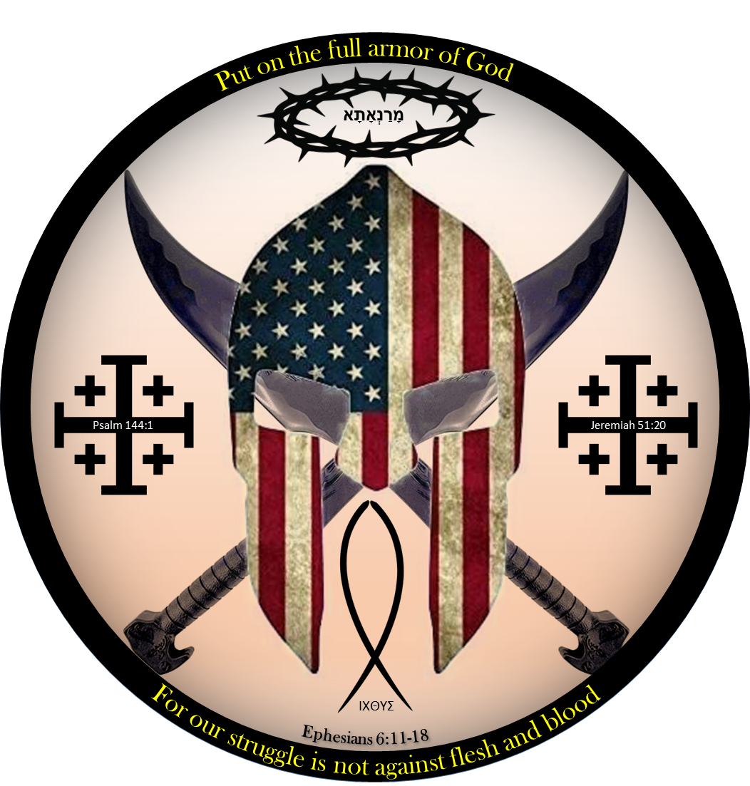
THANK YOU
John Messina
484-682-7608
jmessina@ptd.net

